Slide 1
10-7
Areas of Circles and Sectors

Slide 2

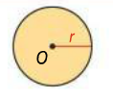
Area of a Circle

Slide 3

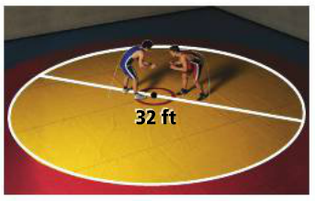
Problem 1: Finding Area of a Circle

Slide 4
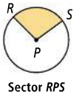
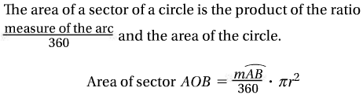
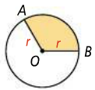
Sector of a Circle: a region bounded by an arc of the circle and the two radii to the arc’s endpoints.
Area of a Sector of a Circle

Slide 5
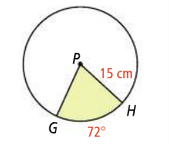
Problem 2: Finding the Area of a Sector of a Circle

Slide 7

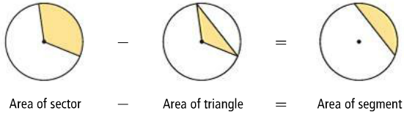
Area of a Segment
Segment of a Circle: a part of a circle bounded by an arc and the segment joining its endpoints

Slide 8
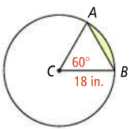
Problem 3: Finding the Area of a Segment of a Circle

Slide 9
