Slide 1
12-3 Measures of Central Tendency and Dispersion

Slide 2
Measures of Central Tendency: Mean, Median, and Mode
Mean (average): $\frac{sum of the data values}{total number of data values}$
Median: the middle value of a data set when the values are arranged in order
Mode: the data item that occurs the most (can have none, one, or more)

Slide 3
Problem 1: Finding Measures of Central Tendency
What are the mean, median, and mode of the bowling scores below?
Bowler 1 | 104
Bowler 2 | 117
Bowler 3 | 104
Bowler 4 | 136
Bowler 5 | 189
Bowler 6 | 109
Bowler 7 | 113
Bowler 8 | 104

Slide 4
Problem 2: Finding a Data Value
Your grades on three exams are 80, 93, and 91. What do you need on the next exam to have an average of 90 on the four exams?

Slide 5
Measure of Dispersion: describes how dispersed, or spread out, the values in a data set are
Range of a set of data: the difference between the greatest and least data values

Slide 6
Problem 3: Finding the Range
The closing prices, in dollars, of two stocks for the first five days in February are shown. What are the range and mean of each set of data? Use the results to compare the data.
STOCK A: | STOCK B:
25 | 34
30 | 28
30 | 31
47 | 36
28 | 31

Slide 7
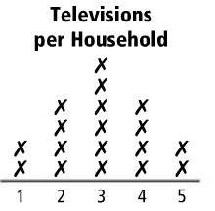
Problem 4: Finding Measures of Central Tendency and Ranges
The results of a survey on the number of televisions in students’ households are shown
Calculate the mean, median, and range of the data
How can you tell from the graph that the mean and the median are equal?

Slide 8
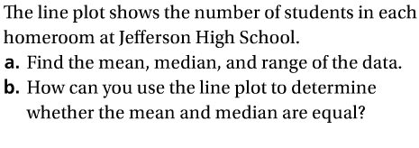
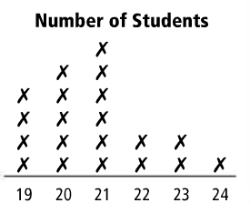

Slide 9
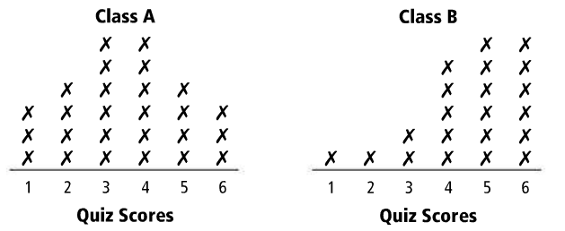
Problem 5: Comparing Measures of Central Tendency
The results from the same quiz to two different classes are shown
By comparing the line plots, how can you tell which mean is greater?
Who has the greater median?

Slide 10
